Slide 1


UE23CS441A – Capstone Project Phase – 3
Project Progress Review #1
E.C.H.O.
Efficient Contextualized History Orchestrator
Project ID: 92
Project Guide: Dr. M. Shalima Sulthana
Team Members:
Mrigank Jain — PES2UG23CS352
Mohammed Mir Fazlai Ali — PES2UG23CS346
Mohammed Shehzaad Khan — PES2UG23CS349
Arjun Sai N — PES2UG23CS091

Slide 2

Outline
Abstract and Scope of the Project
Architecture diagram/complete pipeline of project(mention all the modules)
Summary of Capstone Project Phase – 2 work
Detailed explanation of modules developed so far (post phase-2)
Demo, results and outputs of each module (with screenshots)
Performance metric for module/ collection of modules, and its comparison with baseline
Contribution of each team member
Remaining modules to be completed
Gantt Chart indicating tasks completed post phase-2 and plan ahead for current semester
Github repository (with code database) ( Private: only team and respective guide)
References in IEEE format ( baselines with which work is compared with modules adapted form)

Slide 3

The Problem: Fragmented Digital History
Personal digital context is fragmented across multiple applications. A user may:
Read an email in Gmail
Search related articles in Chrome
Watch a YouTube tutorial
But later cannot reconstruct the sequence or find the information across separate applications.
E.C.H.O. solves this by creating a unified, searchable memory layer that connects activity across all the above sources.

Slide 4



Abstract and Scope of the Project
ABSTRACT:
E.C.H.O. addresses fragmented personal digital history across Gmail, Chrome, and YouTube. Instead of forcing users to remember which application contained a previous interaction, the system creates a unified, searchable memory layer.
The system captures meaningful activity, stores source-aware canonical records, enriches them for semantic search, retrieves context through hybrid deterministic retrieval, and presents results through a React dashboard and Chrome extension popup.
Phase III focus: system integration, reliable enrichment/indexing, retrieval-quality improvements, digital wellbeing analytics, and UI completion.

Slide 5
Project Scope
The E.C.H.O. system encompasses:
Gmail, Chrome, and YouTube activity capture
Canonical memory storage with source-specific metadata
Intent-aware capture and revisit detection
Background enrichment, classification, and FAISS semantic indexing
Natural-language hybrid retrieval with conversational context
Digital wellbeing analytics and user-controlled reflections
React dashboard, browser extension popup, settings, exp
All functionality is designed with privacy-first principles and local-first architecture.

Slide 6

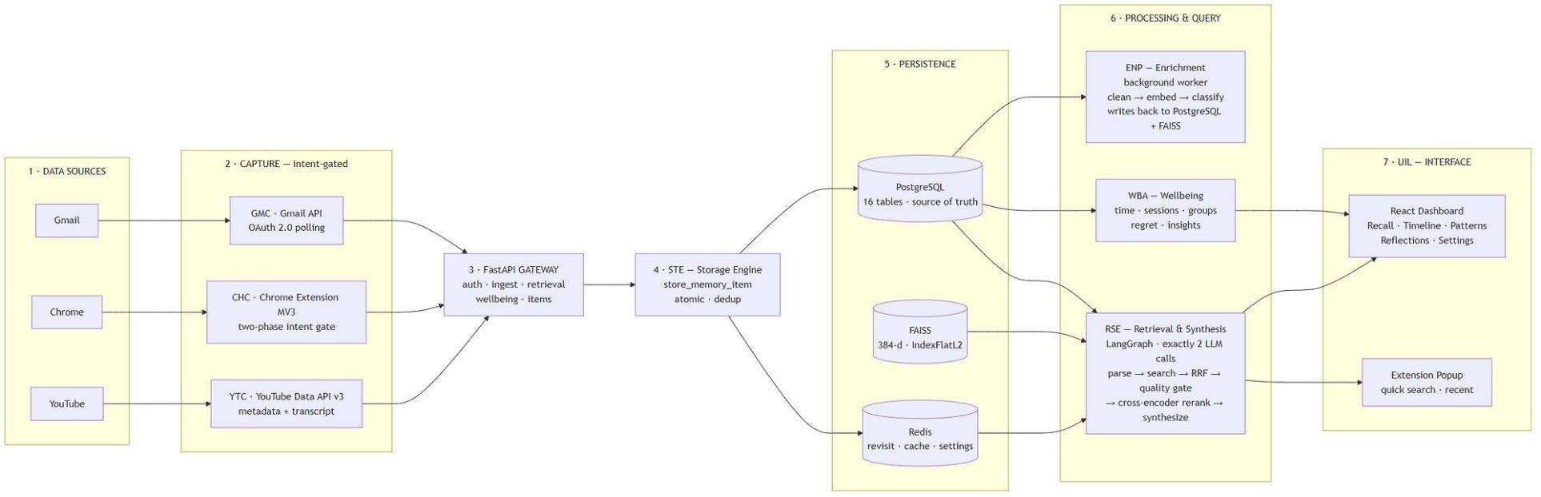
E.C.H.O. Complete Architecture and Data Flow
LAYER 1 - DATA SOURCES:
Gmail via OAuth/API
Chrome browser activity via Manifest V3 extension
YouTube watch activity and metadata
LAYER 2 - CAPTURE AND PRIVACY LAYER:
Source-specific capture controls
Chrome two-phase engagement gating
Revisit detection
Excluded domains and senders
No typed-text or incognito capture
LAYER 3 - CANONICAL STORAGE LAYER:
PostgreSQL as permanent source of truth
Unified memory_items records
Gmail, Chrome, YouTube metadata tables
Engagement records
Redis for revisit state, settings, reminders, and temporary caches

Slide 7

E.C.H.O. Architecture: Enrichment, Retrieval & Presentation
LAYER 4 - ENRICHMENT AND INDEXING LAYER:
LAYER 5 - RETRIEVAL AND SYNTHESIS LAYER:
LAYER 6 - PRESENTATION LAYER:
Clean source text
Build source-aware embeddable text
Generate all-MiniLM-L6-v2 embeddings
Classify into work, study, entertainment, personal, or misc
Store and maintain FAISS semantic index
Parse intent
Resolve time anchors
PostgreSQL keyword search + FAISS semantic search in parallel
Reciprocal Rank Fusion
Deterministic quality evaluation
Cross-encoder reranking
LLM answer synthesis
React dashboard
Chrome extension popup
Wellbeing analytics and user controls

Slide 8
Summary of Capstone Project Phase II Work
PHASE II FOUNDATION
Canonical PostgreSQL schema covering memory items, source metadata, engagement, embeddings, sessions, groups, regret events, and conversation history. Initial storage-engine abstractions for Gmail, Chrome, and YouTube records. Chrome extension activity capture and source-specific engagement signals. Initial enrichment components for cleaning, embeddings, classification, and FAISS. Initial LangGraph retrieval structure.

Slide 9
Phase III Extensions and Improvements
Phase III: What We Improved, What We Added
1 · Retrieval graph expanded
Grew from 9 nodes to 14, with keyword and semantic search running in parallel.
2 · Search quality
Added rank fusion to merge keyword and semantic results, then cross-encoder re-ranking. Still exactly 2 LLM calls per query.
3 · Single storage path
All three sources now write through one gateway and one storage engine, with duplicate prevention.
4 · Enrichment reliability
Items track pending, processed, and failed state. Failed items retry without being wrongly marked done. Index updates incrementally.
5 · Wellbeing, dashboard and extension popup
Initial implementation. Not yet validated on live data.

Slide 10

Integration & Platform Stability
Mrigank Jain — PES2UG23CS352
RESPONSIBILITIES:
1
Build the API gateway connecting the extension and dashboard to the backend
2
Keep all source connectors reachable through one consistent set of endpoints
3
Expose runtime settings so capture can be controlled without restarting
4
Provide health visibility for the running system
5
Build command-line tools to set up, inspect and repair the system
IMPLEMENTED WORK:
One FastAPI application serving the Chrome extension and React dashboard, with six router groups in active use. Health endpoint polled every 15 seconds by the dashboard. Runtime capture settings changeable from the Settings page. Command-line tools for database setup, enrichment status, reprocessing, index rebuild and centroid recomputation. Approximately 1,470 lines of code.

Slide 11

Integration & Platform Stability: Technical Details
Mrigank Jain — PES2UG23CS352
TOOLS USED
Tool | Category
FastAPI | API framework
Uvicorn | ASGI server
Pydantic | Request validation
psycopg2 | PostgreSQL driver
python-dotenv | Environment configuration
PostgreSQL | Database
CODE CONTRIBUTED
Approximately 1,470 lines

Slide 12


Enrichment & Semantic Indexing
Mohammed Mir Fazlai Ali — PES2UG23CS346 | Enrichment & Indexing Owner
Load Context
Clean Data
Create Embeddable Text
Embed & Index
This pipeline enriches raw memory items, converts them into source-aware embeddable text, and stores them in the semantic index for reliable retrieval.
DELIVERABLE:
Reliable source-aware enrichment and indexing lifecycle with explicit pending, processed, failed, and retry behaviour.

Slide 13
Enrichment & Indexing: Technical Implementation
Mohammed Mir Fazlai Ali — PES2UG23CS346
IMPROVED FROM PHASE II
Source-aware text cleaning — Gmail strips HTML, tracking pixels, signatures and quoted replies; Chrome extracts readable article content; YouTube combines title, description and transcript
Embedding generation using all-MiniLM-L6-v2, producing 384-dimension vectors locally
Four-stage classifier — structural signals, domain lookup, centroid similarity, then LLM fallback
Two-tier attachment handling, with full text extracted on demand during retrieval
NEW IN PHASE III
Items that fail processing are marked and held separately, so they are never wrongly counted as complete
Incremental index updates — new items are appended instead of rebuilding the whole index
Classifier centroids now saved to disk and refreshed by a maintenance script
Deferred handling for YouTube items still awaiting metadata
MODEL
all-MiniLM-L6-v2 — 384-dimension sentence embeddings.
LIBRARIES
Tool | Category
sentence-transformers | Embedding generation
faiss-cpu | Vector index
scikit-learn | Centroid similarity
NumPy | Vector maths
BeautifulSoup4 | HTML cleaning
readability-lxml | Article extraction
pypdf | PDF text extraction
pdfplumber | PDF text extraction
python-docx | Word document extraction
Pillow | Image handling
psycopg2 | PostgreSQL driver

Slide 14

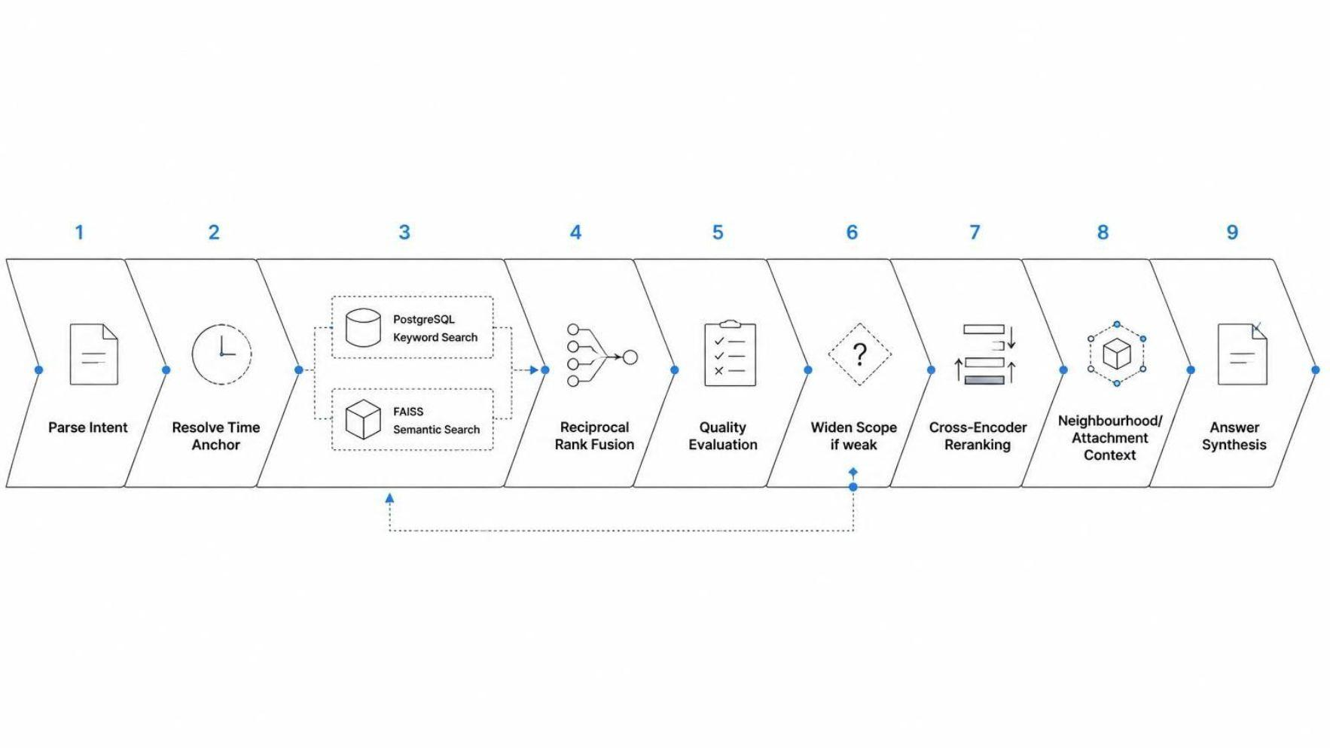
Retrieval Intelligence and Quality Path
Mohammed Shehzaad Khan — PES2UG23CS349
Hybrid retrieval architecture built with LangGraph to combine keyword search, semantic search, deterministic quality checks, and self-correcting reranking for stronger answer generation.
ARCHITECTURE OVERVIEW:
LangGraph orchestrates the retrieval workflow end to end
PostgreSQL keyword retrieval and FAISS semantic retrieval run in parallel
Reciprocal Rank Fusion combines ranking signals safely by position
Deterministic quality checks gate weak or incomplete retrieval results
Cross-encoder reranking and surrounding context support improve final relevance
DELIVERABLE:
Hybrid deterministic retrieval intelligence implemented, with final empirical relevance benchmarking and query-by-query tuning remaining.

Slide 15

Retrieval Intelligence: Technical Implementation
Mohammed Shehzaad Khan — PES2UG23CS349
IMPROVED FROM PHASE II
Retrieval graph expanded from 9 nodes to 14
Keyword and semantic search now run in the same graph step and merge at fusion, instead of one after the other
Self-correcting loop that widens the search up to three times before giving up
NEW IN PHASE III
Rank fusion merges keyword and semantic results by position rather than raw score
Cross-encoder re-ranking re-scores candidates against the original question
Time-anchor resolution turns "after the interview email" into a hard date constraint by finding that item first
Surrounding-context retrieval pulls nearby items from the same email thread or activity session
Still exactly 2 LLM calls per query — everything between them is deterministic Python

Slide 16
MODELS
Model | Purpose
ms-marco-MiniLM-L-6-v2 | Cross-encoder re-ranking
Gemini 2.5 Flash | Intent parsing and answer synthesis
LIBRARIES
Tool | Category
LangGraph | Stateful retrieval graph
LangChain Core | LLM abstraction, structured output
LangChain Community | Conversation history storage
sentence-transformers | Cross-encoder model loading
faiss-cpu | Semantic vector search
NumPy | Vector maths
psycopg2 | PostgreSQL driver

Slide 17
Digital Wellbeing & User Interface Layer
Arjun Sai N — PES2UG23CS091
RESPONSIBILITIES
Build the web dashboard users interact with
Build the browser extension popup for quick access
Connect every screen to the backend API
Keep the interface usable when the backend is unavailable
Begin work on wellbeing analytics
NEW IN PHASE III
Recall — ask a question in plain language and see the answer
Timeline — browse recent captured items and mark regret
Patterns — daily time summary, category breakdown and activity heatmap
Reflections — regret analytics and currently regretted items
Settings — capture toggles for Gmail, Chrome and YouTube
Extension popup — quick search and recent items without opening the dashboard
Demo mode — every screen falls back to sample data when the backend is offline, so the interface never breaks
Custom-built visualisations, written directly rather than using a chart library

Slide 18
User Interface Layer: Dashboard & Extension
Arjun Sai N — PES2UG23CS091
FRAMEWORK AND BUILD
Tool | Category
React 18 | UI framework
TypeScript | Type-safe development
Vite | Build tool and dev server
Tailwind CSS | Styling
PostCSS | CSS processing
Autoprefixer | CSS processing
LIBRARIES
Tool | Category
React Router | Page navigation
Framer Motion | Interface animation
GSAP | Animation timelines
Lenis | Smooth scrolling
Lucide React | Icon set
Fontsource | Locally bundled fonts, no CDN

Slide 19
Individual Contributions
MRIGANK JAIN — PES2UG23CS352 | MOHAMMED MIR FAZLAI ALI — PES2UG23CS346
FastAPI and endpoint consistency Canonical storage workflow Source metadata and engagement handling Health/operational scripts Connector validation coordination | Source-specific context assembly Text cleaning and embeddable text Embedding generation FAISS lifecycle Classification and preprocessing state handling

Slide 20
Individual Contributions - Retrieval & Wellbeing
MOHAMMED SHEHZAAD KHAN — PES2UG23CS349
ARJUN SAI N — PES2UG23CS091
Digital Wellbeing & UIL
Retrieval Intelligence
Time/session analytics
Groups and review queue
Regret and weekly insight system
FastAPI wellbeing APIs
React dashboard and extension popup
LangGraph retrieval path
PostgreSQL + FAISS hybrid retrieval
RRF and cross-encoder reranking
Time anchors and fallback logic
Quality evaluation set and metrics

Slide 21
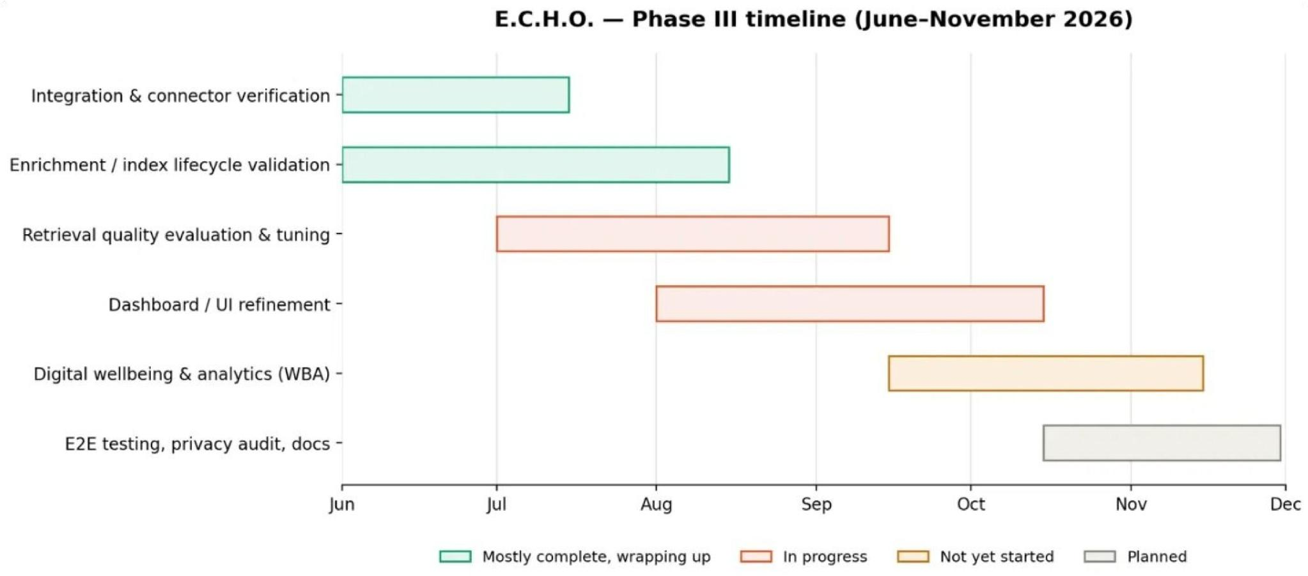
Remaining Work and Phase III Completion Plan
A high-level timeline of the remaining Phase III workstreams, showing current progress and the final validation/refinement stages ahead.

Slide 22
Remaining Work: Detailed Task Breakdown
1 · Wellbeing analytics
Complete the time, session and regret analytics, and validate them against real captured data.
2 · Dashboard refinements
Add source citation cards with timestamps and excerpts to the Recall page. Add a dedicated source-breakdown visual.
3 · End-to-end validation
Run all three connectors live and confirm capture, storage, enrichment and indexing work together on real data.
4 · Retrieval quality measurement
Run the evaluation set on captured data and record relevance, coverage and response time against a baseline.
5 · Privacy audit and documentation
Verify no personal data leaves the local machine through any code path, then complete final documentation.

Slide 23
Repository, References, and Conclusion
REPOSITORY SECTION:
GitHub Repository: https://github.com/Shehzaad-khan/Efficient-Contextualized-History-Orchestrator-E.C.H.O.git
Repository Overview:
backend/: FastAPI gateway, retrieval, wellbeing, user-data controls
ste/: storage, PostgreSQL, Redis, FAISS, settings
enp/: enrichment, cleaning, embeddings, classification
rse/: LangGraph hybrid retrieval engine
wba/: time analytics, sessions, groups, regret, insights
frontend/: React dashboard
extension/: Chrome Manifest V3 extension and popup
scripts/: setup, auth checks, enrichment maintenance
docs/: architecture and database design documents
CONCLUSION:
Phase III advances E.C.H.O. from a modular foundation toward an integrated local-first memory system. The repository contains canonical storage, source-aware enrichment and FAISS indexing, deterministic hybrid retrieval, digital wellbeing analytics, and a React/Chrome-extension interface. The final phase focuses on runtime reconciliation, empirical validation, UI refinements, privacy verification, and complete end-to-end testing.

Slide 24
References and Key Technologies
REFERENCES (IEEE Format):
[1] N. Reimers and I. Gurevych, "Sentence-BERT: Sentence embeddings using Siamese BERT-networks," in Proceedings of the 2019 Conference on Empirical Methods in Natural Language Processing, 2019.
[2] J. Johnson, M. Douze, and H. Jégou, "Billion-scale similarity search with GPUs," IEEE Transactions on Big Data, vol. 7, no. 3, pp. 535–547, 2021.
[3] LangChain and LangGraph Documentation, "Building language model applications with composable components," https://python.langchain.com, 2024.
[4] M. Kleppmann, A. Wiggins, P. van Hardenberg, and M. McGranaghan, "Local-first software: You own your data, in spite of the cloud," in Proceedings of the 2019 ACM SIGPLAN International Symposium on New Ideas, New Paradigms, and Reflections on Programming and Software, 2019.
[5] A. Thorp, "Digital wellbeing and regrettable usage patterns: A framework for understanding and supporting healthy digital habits," Journal of Digital Wellbeing, vol. 5, no. 2, pp. 112–128, 2023.

